Slide 1
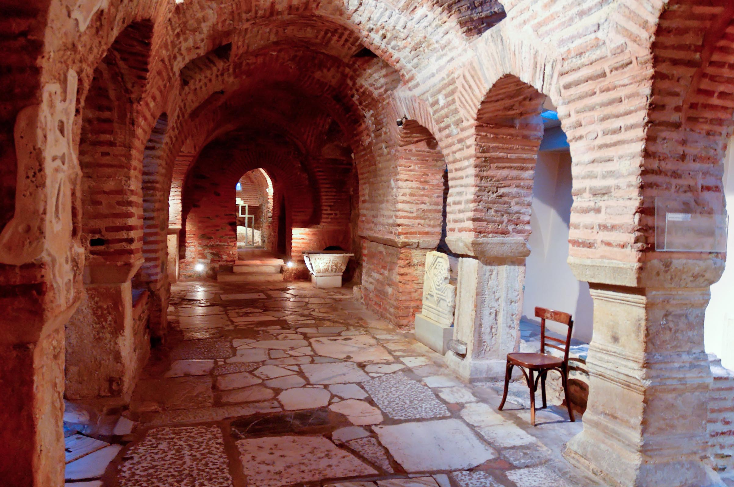
1 Thessalonians 5.11-18: Christian Life in the Church
image of Roman road and baths
from Pictorial Library of Bible Lands
©2012 Todd Bolen / BiblePlaces.com

Slide 2
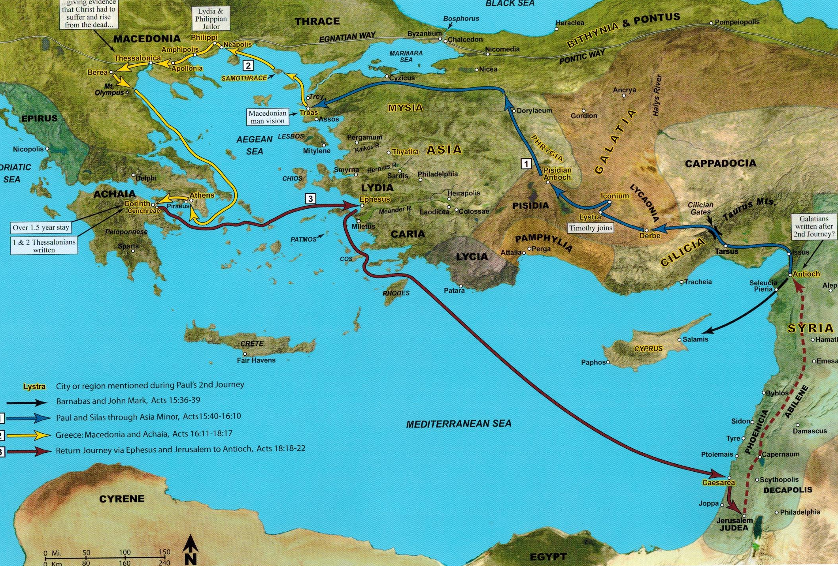
map 10-3 from Satellite Bible Atlas ©2013 William Schlegel

Slide 3
1 Thessalonians 5.11 NET: Therefore encourage one another and build up each other, just as you
are in fact doing.
οἰκοδομέω = to strengthen/build up/edify
παρακαλέω = to exhort/encourage/comfort

Slide 4
1 Thessalonians 5.9-11 NET: For God did not destine us for wrath but for gaining salvation through our Lord Jesus Christ. He died for us so that whether we are alert or asleep we will come to life together with him.
Therefore encourage one another and build up each other, just as you are in fact doing.

Slide 5
1 Thessalonians 5.12-13 NET: Now we ask you, brothers and sisters, to acknowledge
those who labor among you and preside
over you in the Lord and admonish you,
and to esteem them most highly
in love because of their work. ἐρωτάω =
Be at peace among yourselves. to ask/request
[to beseech]
νουθετέω = to admonish/warn/instruct

Slide 6
1 Thessalonians 5.12-13 NET:
Now we ask you, brothers and sisters, to acknowledge those who labor among you and preside over
you in the Lord and admonish you, and to
esteem them most highly in love because of
their work. Be at peace among yourselves.
οἶδα = to know/respect/honor
ἡγέομαι = to regard/esteem/respect

Slide 7
1 Thessalonians 5.12-13 NET: Now we ask you, brothers and sisters, to acknowledge those who labor among you and preside over you in the Lord and admonish you, and to esteem them most highly in love because of their work. Be at peace among yourselves.
Listen to them and consider their teaching

Slide 8
1 Thessalonians 5.12-13 NET: Now we ask you, brothers and sisters, to acknowledge those who labor among you and preside over you in the Lord and admonish you, and to esteem them most highly in love because of their work. Be at peace among yourselves.
Listen to them and consider their teaching
Value their care and counsel [even admonishment]

Slide 9
1 Thessalonians 5.12-13 NET: Now we ask you, brothers and sisters, to acknowledge those who labor among you and preside over you in the Lord and admonish you, and to esteem them most highly in love because of their work. Be at peace among yourselves.
Listen to them and consider their teaching
Value their care and counsel [even admonishment]
Accept their ministry leadership

Slide 10
1 Thessalonians 5.14 NET:
And we urge you, brothers and sisters, admonish the
undisciplined, comfort the discouraged,
help the weak, be patient toward all.
παρακαλέω = to exhort/encourage/comfort

Slide 11
1 Thessalonians 5.14 NET:
And we urge you, brothers and sisters, admonish the undisciplined, comfort the discouraged,
help the weak, be patient toward all.
νουθετέω = to admonish/warn/instruct
ἄτακτος = disorderly/insubordinate/
without socially recognized constraints

Slide 12
1 Thessalonians 5.14 NET: And we urge you, brothers and sisters, admonish the undisciplined, comfort
the discouraged, help the weak, be patient
toward all.
παραμυθέομαι = to console/cheer up
ὀλιγόψυχος = faint hearted/discouraged

Slide 13
1 Thessalonians 5.14 NET: And we urge you, brothers and sisters, admonish the undisciplined, comfort
the discouraged, help the weak, be patient toward all.
ἀντέχω = to cling to/
be devoted to/help
ἀσθενής = physically sick or weak/
spiritually weak of faith

Slide 14
1 Thessalonians 5.14 NET: And we urge you, brothers and sisters, admonish the undisciplined, comfort
the discouraged, help the weak, be patient toward all.

Slide 15
1 Thessalonians 5.15 NET: See that no one pays back evil for evil to anyone, but always pursue what is
good for one another and for all.
διώκω = to pursue/strive for
ἀγαθός = good as in beneficial or helpful

Slide 16
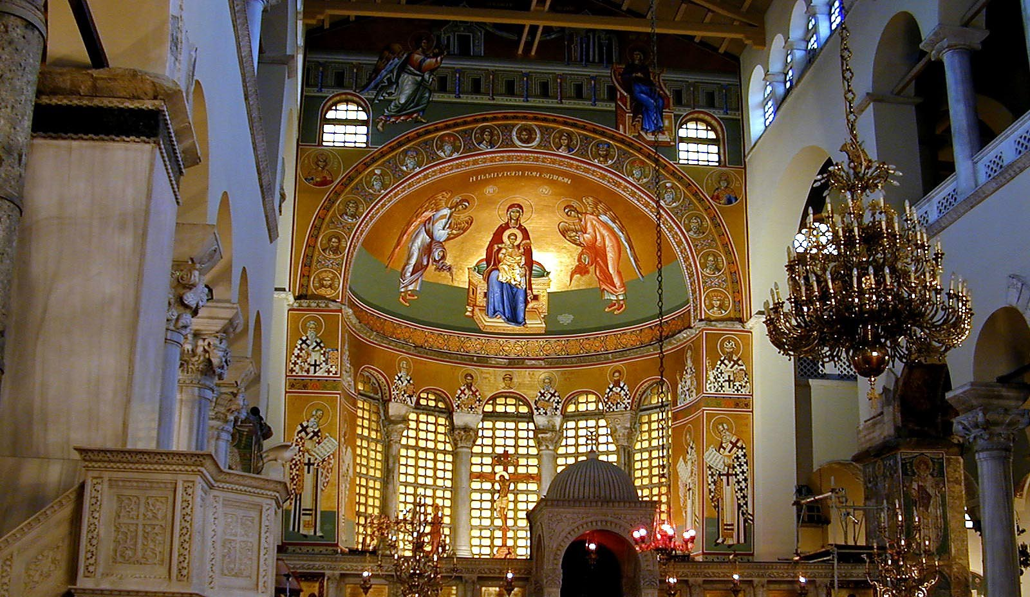
1 Thessalonians 5.16-18 NET: Always rejoice, constantly pray, in everything give thanks. For this is God's will for you in Christ Jesus.
Church of St. Demetrios
Pictorial Library of Bible Lands; ©2012 Todd Bolen; BiblePlaces.com

